Slide 1
Capstone Project Date-A-Scientist
Machine Learning Fundamentals
Claire Morel
27 May 2019

Slide 2
Capstone Project
# Exploring our data source
# Q1 (classification)
# Q2 (regression)
# Conclusion

Slide 3
# Exploration of dating website data
Advantages
Dating websites give a wealth of information!
Limits
Population bias - single males overepresented
Possible « fake » profiles

Slide 4
#Exploration of dating website data Status variable
Status | Observations
single | 55597
seeing someone | 2064
available | 1865
married | 310
unknown | 10
A big database of almost 60K observations
Of course, dating data is not representative of general population (93% of single)

Slide 5
# Exploration of dating website data Body type variable
body_type | # num of observations
average | 14652
fit | 12711
athletic | 11819
thin | 4711
curvy | 3924
a little extra | 2629
skinny | 1777
full figured | 1009
overweight | 444
jacked | 421
used up | 355
rather not say | 198
A lot of fit and athletic people
Is profile data 100% reliable ?

Slide 6
# Question 1 - Vegeterians
Let’s take advantage of having recent data to study a growing trend: vegetarian/vegan diet.
Is it really an individual choice or sociologically determined i.e « can we predict the likely hood of being vegeterian based on socio charateristics? »

Slide 7
# Q1 – Veg_code, a new variable
Diet > veg_code = 1 | Observations
mostly vegatarian | 3444
strictly vegetarian | 875
vegetarian | 667
mostly vegan | 338
strictly vegan | 228
vegan | 136
 | 5249
Are there many vegeterians in our database?
Yes , but let’s also include vegans to have a bigger sample
We will construct a new binary variable for « veg diet »
Veg_code = 1 if diet includes the string « veg »
This concerns 19% of people in our database

Slide 8
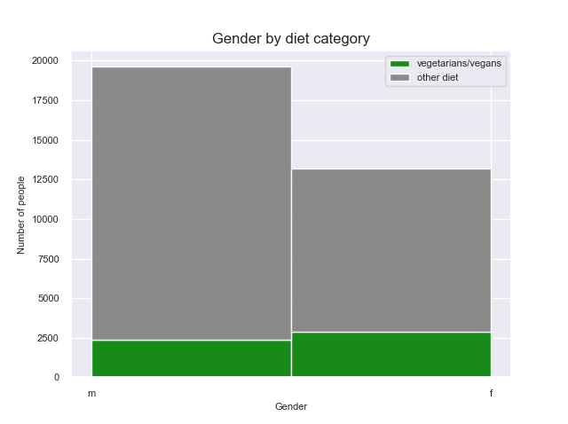
Q1 Graph # More girls have veg diets
There are less girls in the sample, but more of them are « veg ».
Gender could be a good variable to predict a « veg » diet.

Slide 9
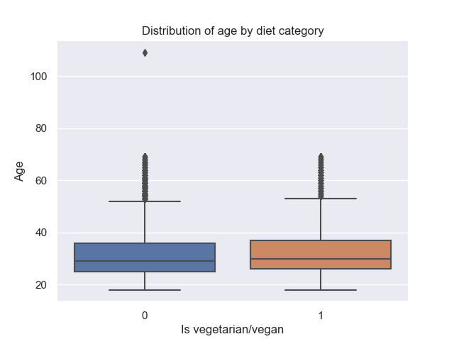
#Q1 Graph - Are «vegs » younger than average?
There is not a huge difference in age distribution between « veg » and other diets.

Slide 10
# Q1 - Predicting « veg_code »requires a classification model
Features : Gender, Age, Education
Labels: « Veg_code »
Step 1: Mapping
Step 2: Normalization
Step 3. Model training
Step 4: Evaluation

Slide 11
# Q1Classification model evaluation
Model | Naive Bayes | SVM
Accuracy | 0.85 | 0.62
Recall | 0 | 0.56
Precision | 0 | 0.22
Running Time | 0.02s | 14s
The Naive Bayes Multinomial is not a good model for binary variables
There are not enough « veg » in the training set. The true positives in y_predict are zero, so the precision as defined by TP/(FP+TP) is zero.
The SVM model works, using a class weight ,to make out for a high imbalance in the training set. The precision is low. There are many false positives. Running time is slow (14s).
We have not seen the logistic regression model in this course but is seems it could be appropriate.

Slide 12
# Question 2 – Age guessing
Dates often lie on their age
Can we accurately guess age base on other charateristics?

Slide 13
# Q2 - A regression question
Age is the variable we want to predict
We suppose the age given in the dating data is correct
We try to build a model to guess age based on gender, diet and bodytype

Slide 14
#Q2 - Regression Model evaluation
 | Multivariable Linear Regression | KNN Regressor
Score | 0.00 | -0.0018
Time | 0.02s | 0.88s
It does not make sense to calculate Accuracy, Precision, Recall for Regression Models
Instead we use .score to calculate R²
R² is just above 0 for the Linar Regression model and negative for the KNN Regressor (worth than using a random approach)
It is probably not a model issue, but just really hard to guess age based on gender, bodytype and diet .

Slide 15
Conclusions and next steps
Warning from data investigation
Dating websites offer large sets of data, but not representative of the general population (male++), and replies could be biased (« fit bodies »)
Classification question
Gender/education/age combined seem to have a weight on adoption of « veg » diets,
but chosen models have poor performance
Regression question
We chose poor variables to guess the age of the potential dates.
Next steps
Classification: test logistic regression. Change sampling method.
Regression: Try using different features, such as preferred music/books

